Slide 1
Grouping and Summarizing Data
Robert Benirschke
July 23, 2023

Slide 2
September 26, 2021 | Session | Instructor
8:30 am - 8:45 am | Course Introduction | Robert Benirschke
8:45 am – 9:30 am | Intro to R and Reproducible Reporting | Amrom Obstfeld
9:45 am - 10:30 am | Coding Basics and Importing Data | Amrom Obstfeld
10:45 am – 11:30 am | Data Transformation | Robert Benirschke
LUNCH
12:30 pm - 1:30 pm | Grouping and Summarizing Data | Robert Benirschke
1:45 pm – 2:45 pm | Data Visualizations | Patrick Mathias
3:00 pm - 3:30 pm | Advanced Reporting | Patrick Mathias

Slide 3
Goals
Learn dplyr tools for grouping and summarizing data in R
Objectives
Calculate a summary statistic for a variable using the summarize() function
Creates groupings of data using the group_by() function
Combine group_by() and summarize() functions to calculate summary statistics for groups of data

Slide 4
Typical Data Science Pipeline
From R for Data Science (https://r4ds.had.co.nz/introduction.html)

Slide 5
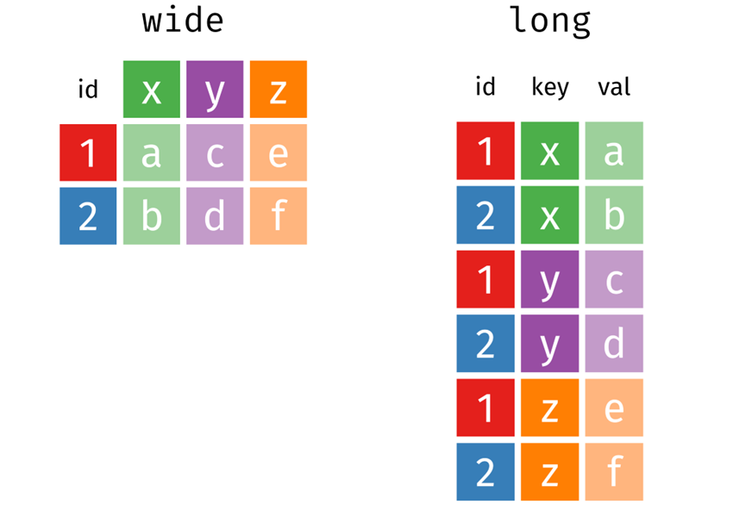
Long vs. Wide Format Data
pivot_longer
pivot_wider
Introduction to the Tidyverse: How to be a Tidy Data Scientist, Olivier Giminez, November 2020 (https://oliviergimenez.github.io/intro_tidyverse/#50)

Slide 6
Summarize()

Slide 7
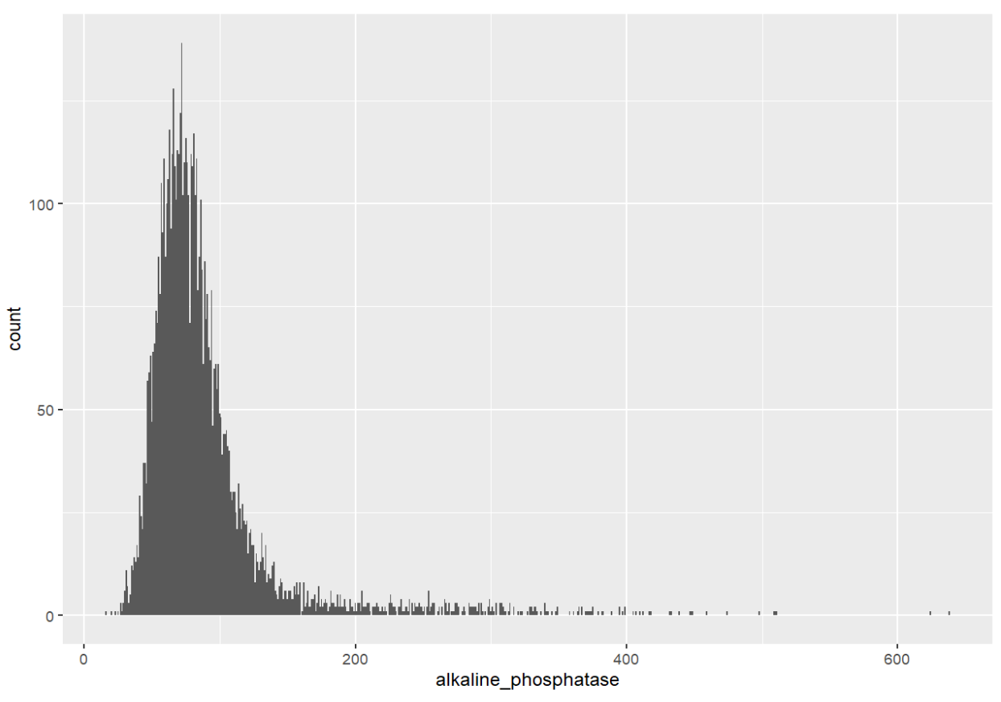
Q: What is the distribution of Alkaline Phosphatase results?

Slide 8
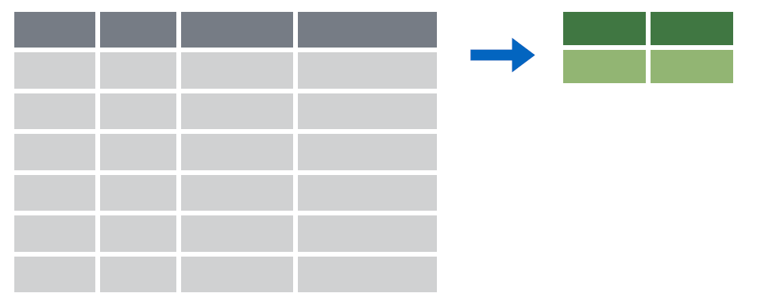

summarize()
Make summaries of your data

Slide 9
summarize()
Make summaries of your data
biochem %>%
summarize(new_variable = calculation)
name for new variable
Value or function

Slide 10
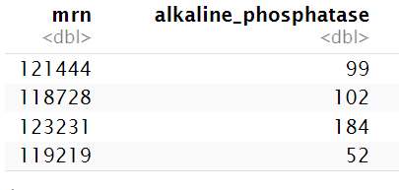
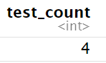
summarize()
function that returns number of observations
Make summaries of your data
biochem %>%
select(mrn, alkaline_phosphatase) %>%
head(4) %>%
summarize(test_count = n())

Slide 11
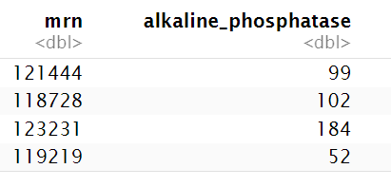
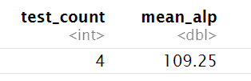
summarize()
function that returns the average value
Make summaries of your data
biochem %>%
select(mrn, alkaline_phosphatase) %>%
head(4) %>%
summarize(test_count = n(),
mean_alp = mean(alkaline_phosphatase))

Slide 12
Your Turn #1
- Open “05 – Group by and Summarize.Rmd”
- Run the setup chunk
- Fill-in gaps to calculate:
a) Median Alkaline Phosphatase concentration
b) Mean Calcium concentration
c ) Interquartile range of Alkaline Phosphatase
d ) Standard deviation of Calcium

Slide 13
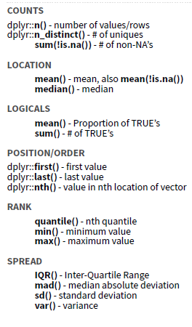

Slide 14
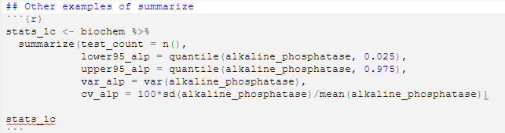
summarize() examples
Calculate the center 95th percentile range
Calculate the variance
Calculate the coefficient of variation

Slide 15
group_by()

Slide 16
group_by()

Slide 17
group_by()
Grouping observations based on a specific variable’s values
biochem %>%
group_by(variable)
name of variable to group by

Slide 18
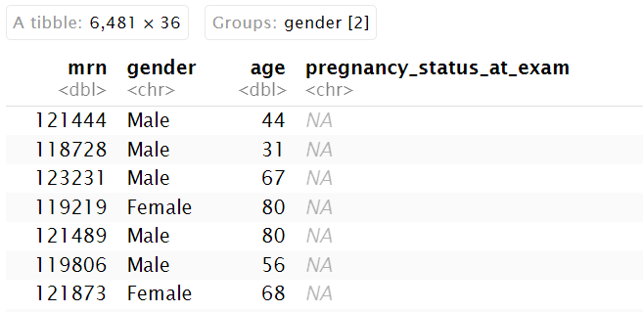
group_by()
Group observations by gender
Biochem %>%
group_by(gender)

Slide 19
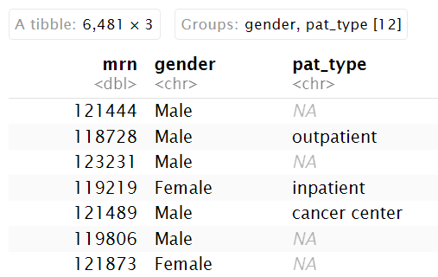
group_by()
Group observations by `gender` and `pat_type`
biochem %>%
select(mrn, gender, pat_type) %>%
group_by(gender, pat_type)

Slide 20
group_by() %>% summarize()

Slide 21
group_by()
%>%
summarize()
Make summaries of your data by group

Slide 22
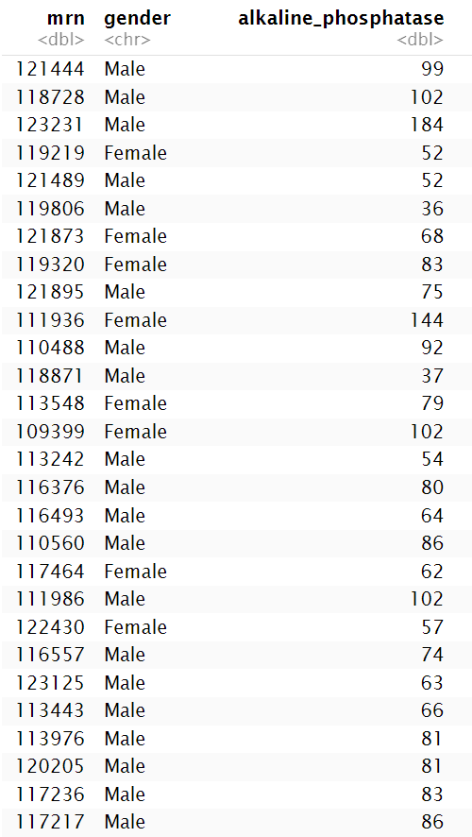
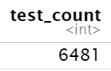
group_by() %>% summarize()
Make summaries of your data
biochem %>%
summarize(test_count = n())

Slide 23
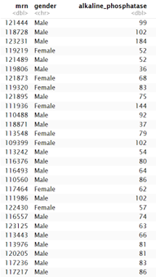
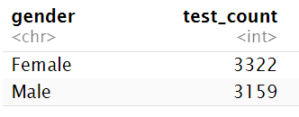
group_by() %>% summarize()
Make summaries of your data
biochem %>%
group_by(gender) %>%
summarize(test_count = n())

Slide 24
Your Turn #3
Calculate:
a) The median Alkaline Phosphatase concentration in Men and Women
b) The median Alkaline Phosphatase concentration in Men and Women over 51

Slide 25
Recap
Summarize() is a function that enables us to calculate summaries of variables (columns).
Common summary activities include counting observations using n(), counting unique observations using n_distinct(), and calculating means using mean().
Group_by() is a function that enables us to create subsets of data by a variable. Data can also be grouped by multiple variables.
Combining the group_by() and summarize() functions is a powerful way to look at summarizations across groups.

Slide 26
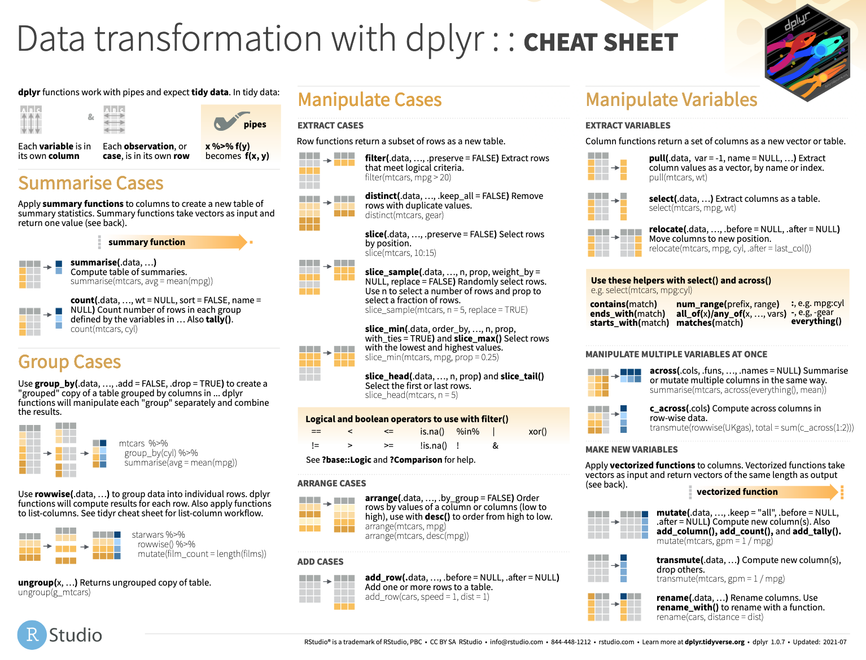

Slide 27
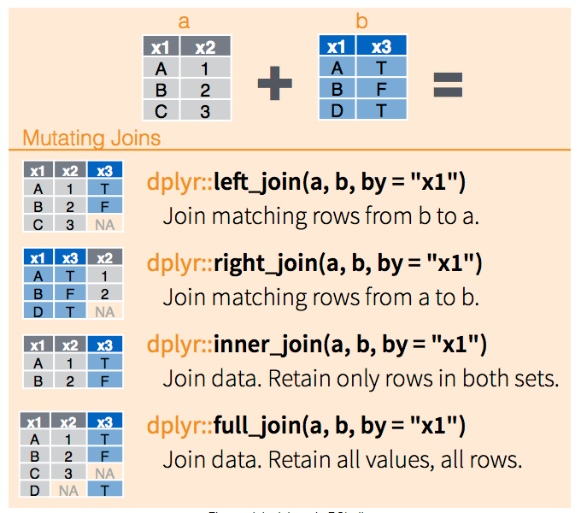
Joining Two Datasets Together
Often you will need to join multiple dataframes together by the values in a column
XXXX_join(DF1, DF2, by=“column_name”

Slide 28
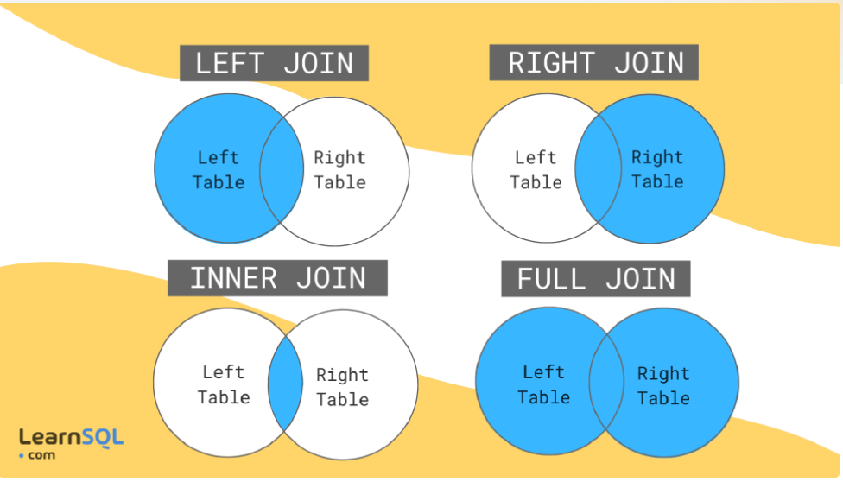
SQL Joins

Slide 29
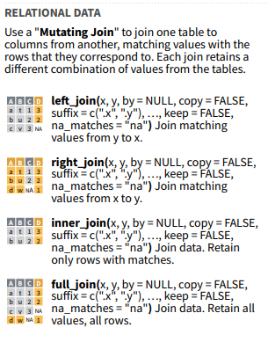
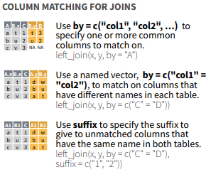
Cheatsheet

Slide 30
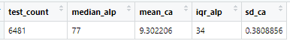
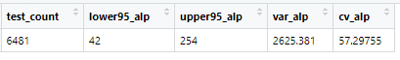
Your Turn!
Use the approriate join command to combine the stats_1b dataframe and stats_1c dataframe using the test_count column.
+

Slide 31
What else?

Slide 32
Statistical Tests

Slide 33
Basic Statisical Tests
T-test
t.test(x, y, paired = FALSE)
Wilkoxon Rank Sum Test
wilcox.test(x, y, paired = FALSE)
Chi Squared Test
chisq.test(df)
Where df is a dataframe that contains categorical count information
The R help documentation provides details for further customization

Slide 34
Is the difference between Men and Women Over 51 Significant?
#filter males over 51
biochem_male <- biochem %>%
filter(gender == "Male" & age >51)
#filter females over 51
biochem_female <- biochem %>%
filter(gender == "Female" & age > 51)
#create variables for alkaline phosphatase
alp_male <- biochem_male$alkaline_phosphatase
alp_female <- biochem_female$alkaline_phosphatase
#perform unpaired wilkoxon rank sum test
wilcox.test(alp_male, alp_female, paired=FALSE)

Slide 35
Results
Wilcoxon rank sum test with continuity correction
data: alp_male and alp_female
W = 767533, p-value < 2.2e-16
alternative hypothesis: true location shift is not equal to 0

Slide 36
Regression Modeling

Slide 37
Linear Regression
lm.fit <- lm(y ~ x, data)
lm.fit <- lm(y ~ x1 + x2 + … + xn, data)
Function for linear regression is “lm”

Slide 38
Example
lm.model <-
lm(blood_urea_nitrogen ~
creatinine + aspartate_aminotransferase, biochem)
summary(lm.model)

Slide 39
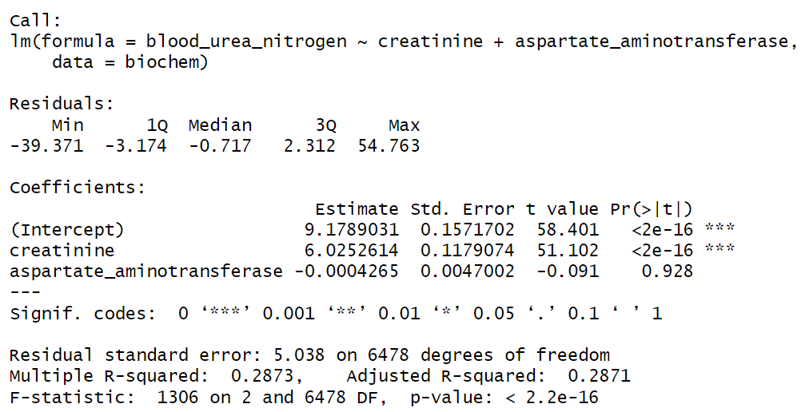
Results

Slide 40
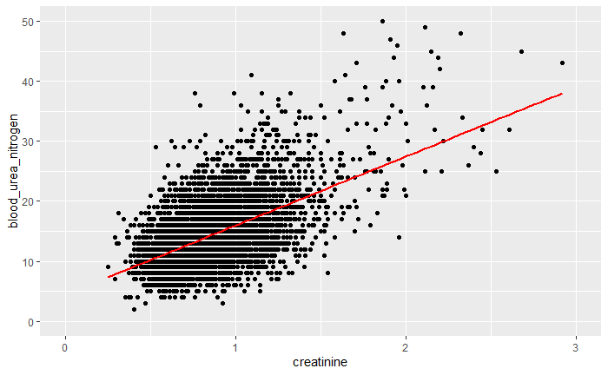
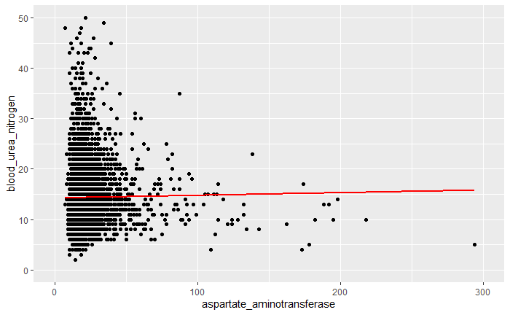
Scatterplots

Slide 41
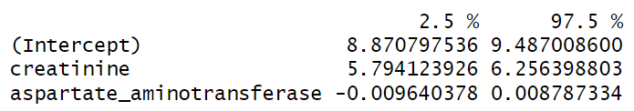
Extracting Information From Model
lm.model$coefficients
BUN = 6.0253*creatinine - 0.0004*AST + 9.1789
confint(lm.model)

Slide 42
Your turn!
Perform a linear regression comparing Alkaline Phosphatase as a function of age and gender.
*Note how the lm function treats a categorical variable when perform this analysis.

Slide 43
Goals
Learn dplyr tools for grouping and summarizing data in R
Objectives
Calculate a summary statistic for a variable using the summarize() function
Creates groupings of data using the group_by() function
Combine group_by() and summarize() functions to calculate summary statistics for groups of data

